Slide 1
Interfacing ThingSpeak with Beaglebone Black Wireless PROJECT: IOT BASED SMART PARKING USING BEAGLEBONE BLACK WIRELESS
SUBMITTED BY:
JOYAL RAJU (C0749019)
Group #1

Slide 2

Contents
Introduction
Setting up ThingSpeak
Coding steps
Output
References

Slide 3
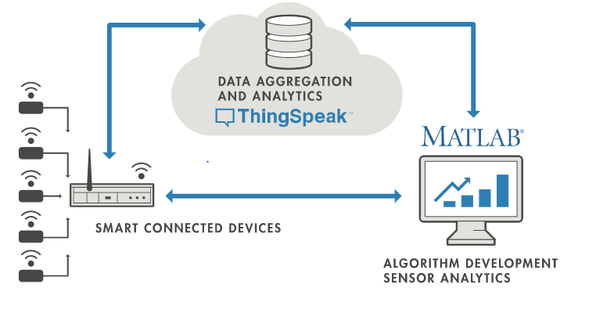
Introduction
It is an open-source IoT application and API
ThingSpeak allows user to aggregate, visualize and analyze live data streams in the cloud
Stores and retrieves data from thingspeak using the HTTP and MQTT protocol over the Internet or via a LAN.
ThingSpeak has integrated support of MATLAB from MathWorks

Slide 4
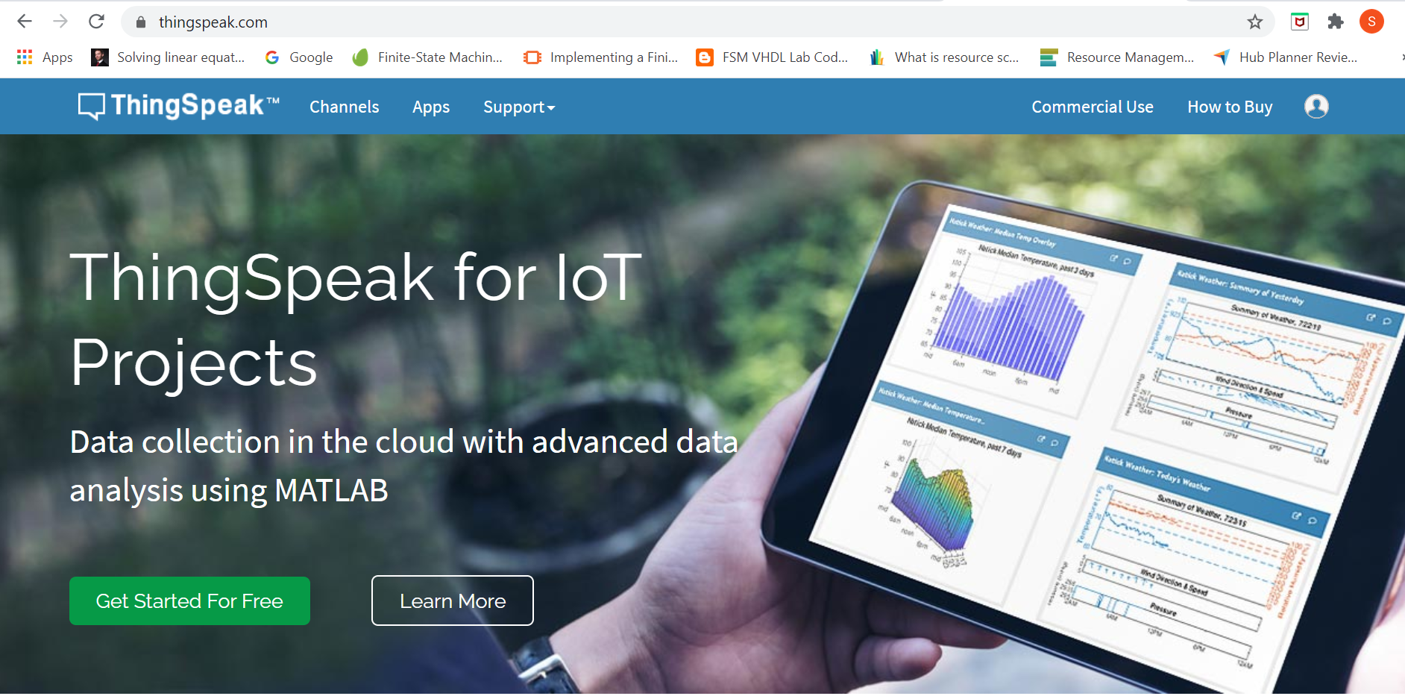
Setting up ThingSpeak
Create a ThingSpeak account by clicking on getting started icon and then register with mail id

Slide 5
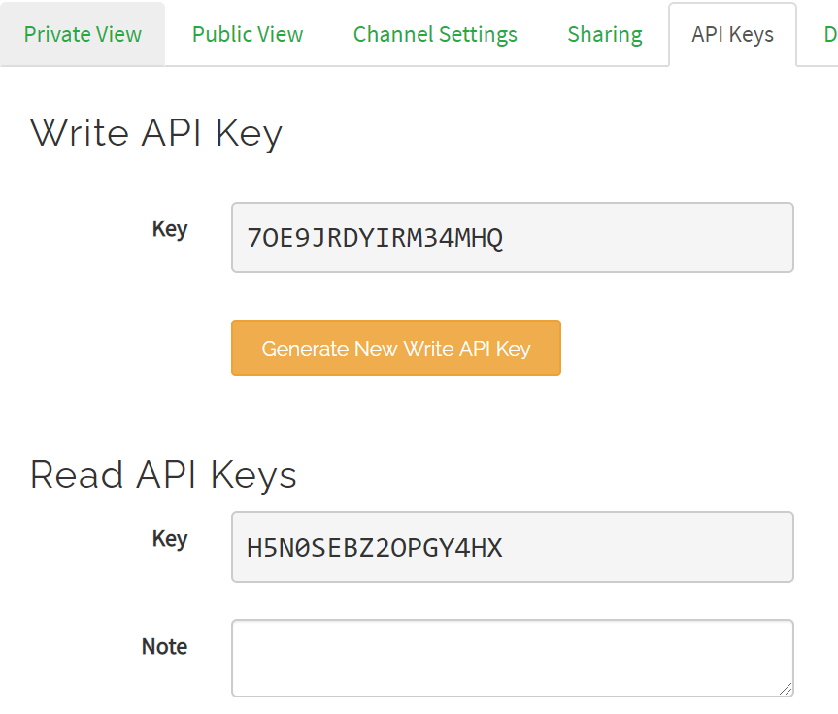
Contd…
Click on create a channel, then complete description and select required number of fields and save the channel by clicking on "Save Channel“
Then click on the "API Key" tab to get API write key for writing to the channel
Channel sharing can be configured by clicking on sharing tab

Slide 6
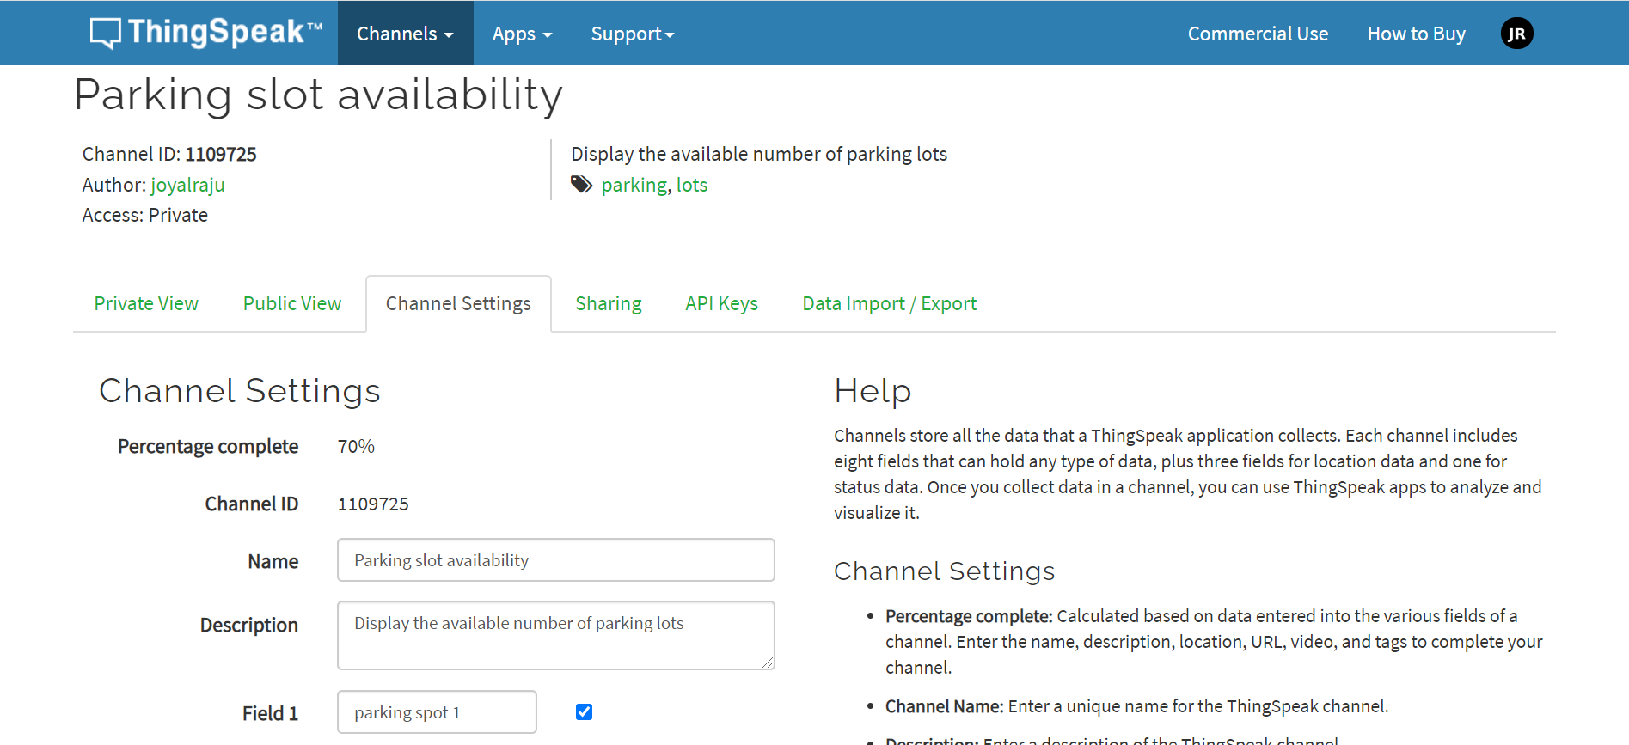
Contd…

Slide 7
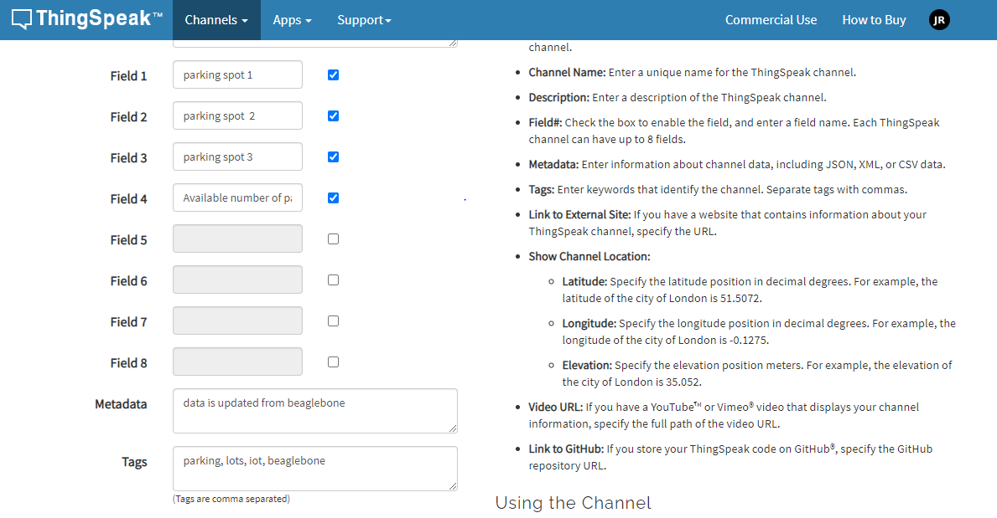

Slide 8
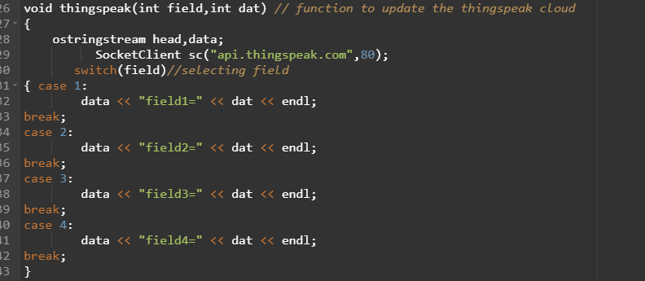
Coding Steps
“thingspeak()” function is used to update data to cloud
ostringstream is used to define head and data. Sstream header provides it.
Socketclient is a class to connect to network host
Data should be modified with respect to field in the channel

Slide 9
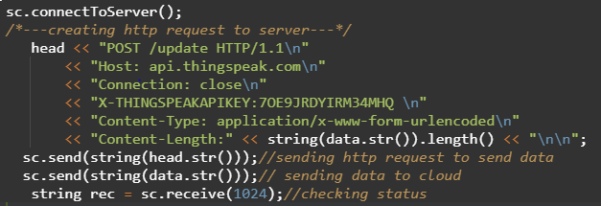
Contd…
To communicate with cloud, a pathway is established using “sc.connectToServer()” command
HTTP request is required to communicate with cloud.
head is used to create the http request along with API key to communicate with cloud
Request and data can be sent as a string using “sc.send()” command
“sc.receive()” is used to check the status of data transferred

Slide 10
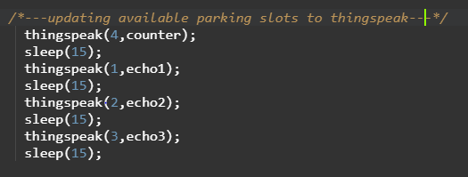
Contd…
Thingspeak function is called to update the data.
15 sec delay is required to update each field it is established by “sleep”
Field 4 of channel is updated with available number of slots
Field 1 of channel is updated with status of ultrasonic 1
Field 2 of channel is updated with status of ultrasonic 2
Field 3 of channel is updated with status of ultrasonic 3

Slide 11
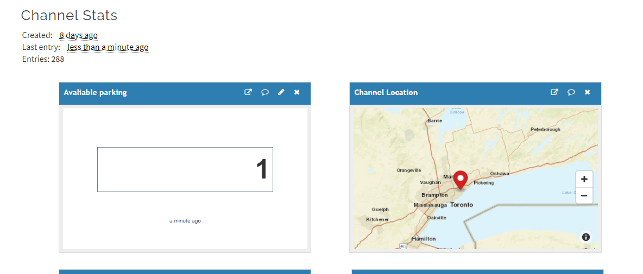
Output

Slide 12
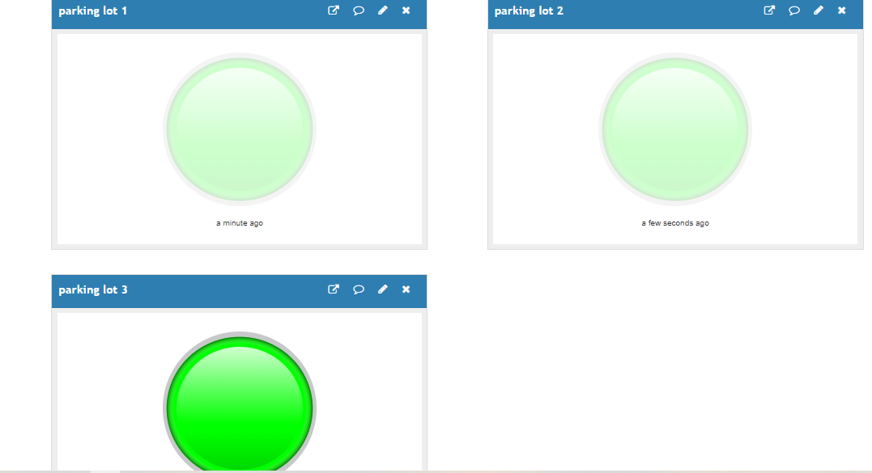
Contd…

Slide 13
References
ThingSpeak. ThingSpeak for IOT Projects retrieved from: https://thingspeak.com/
Noob(2014). Noob’s Guide to Embedded Systems retrieved from: http://noobtechiespeaks.blogspot.com/2014/10/iot-using-beaglebone-black-and.html
Molloy, D. (2019). Exploring BeagleBone: Tools and Techniques for Building with Embedded Linux, Second Edition, New York.

